Slide 1
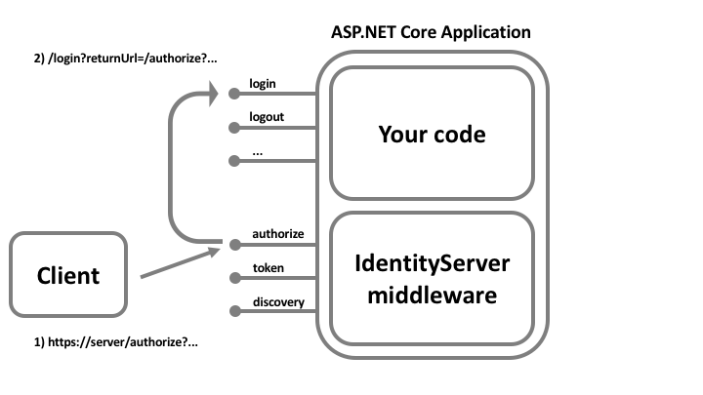
IAM Approaches
Full fledged IAM
develop fully in-house
with IdentityServer4 (IS4)
Data Store
Api Claims
Identity Claims
Client Claims
…
…
DB schema and the structure already comes with IS4
IdentityServer4
Middleware
Possibly a microservice
(2) In-house developed
front-end shell (ASOS)
talks to AWS backend via
an orchestration layer
Orchestration layer
--------------
AWS SDK
IAM Vendor
AWS
ASOS
{ }
Fill the shell with our own code

